Slide 1
New Junior Cycle Parent Information Evening
Wednesday, 15th November 2017
7.00 pm – 8.00 pm

Slide 2
Welcome
Mary Ryan Deputy Principal
Sinéad Moloney Acting Deputy Principal
Triona Murray Home School Community Liaison
Jennifer Kiely English Teacher
New Junior Cycle Trainer
Gillian Galligan English Teacher
Notes:
Junior Cycle for Teachers Support Service

Slide 3
Purpose of the Information Evening
Why change is needed in the Junior Cycle
What will be different
What will stay the same
How you can support your child’s learning in a new junior cycle
Notes:
Junior Certificate replaced the Intermediate Certificate in 1992

Slide 4
A Framework for Junior Cycle
On 4 October, 2012, Minister Quinn published:
A Framework for Junior Cycle. This document contains the Minister's plan to reform the junior cycle in secondary schools.
The need for change was being called for by:
Students
Parents/Guardians
Teachers
Notes:
Passive learning experience
Focus on rote learning often without full understanding
High stake examinations resulting in stress and anxiety for students
Teachers acting as exam coaches rather than educators

Slide 5
Why is there a need for change?
Many students are turned off learning in junior cycle
The Junior Certificate exam is dominating teaching and learning in many Irish classrooms
The curriculum is overcrowded
There is too much emphasis on covering content and not enough time for deeper learning or developing skills
There is a narrow range of assessment activity - lots of tests!
Notes:
ERSI RESEARCH

Slide 6
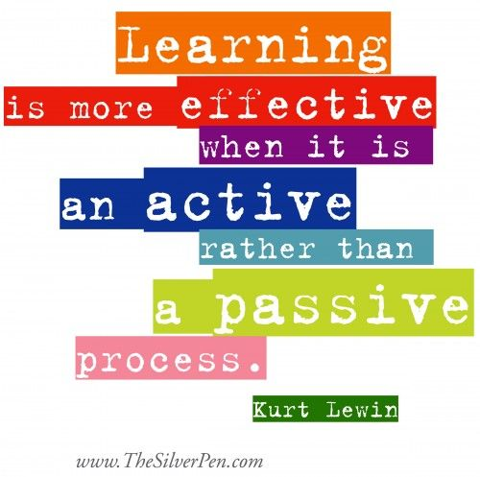
Notes:
School Journal – AFL
Show journal and pens

Slide 7
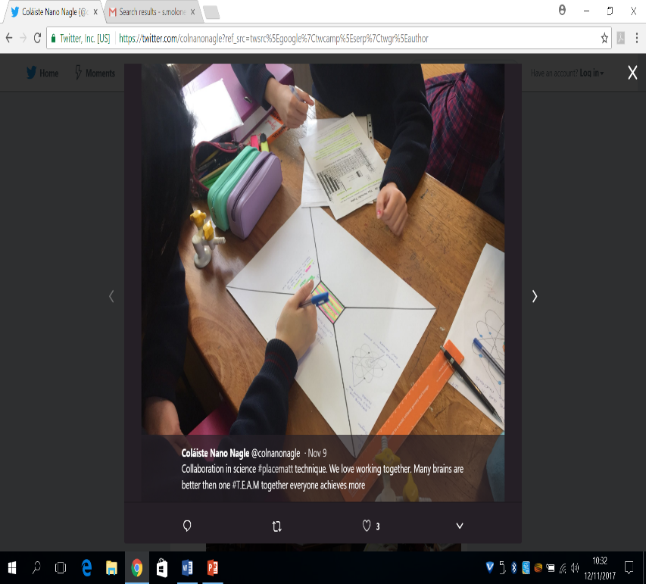

Slide 8
The Student Voice
http://www.juniorcycle.ie/Assessment/Orla

Slide 9
What will be different for your child?
More actively involved in their learning
Greater emphasis on literacy, numeracy and the key skills
Assessment – nearer in time and place to the learning
Improved feedback and reporting to parents/guardians
Notes:
Students will be more actively involved in their learning. We know that students learn best, not when they are passive, but when they are actively engaged in the learning e.g. pair and group work where students complete tasks together or when they engage in peer assessment (this is where they give feedback to their class mates on work that is being done and suggest how it can be improved. When students have to explain something to others, it also improves their own learning……’we learn best when we teach’.
Numeracy Moments – Common Whole School Approach
Key words
Literacy and numeracy will feature in all class learning and not just in maths and language classes. For example, in History, what are the key/new words that I need to learn in this history lesson? How do I arrange the important facts in a clear way in my history homework? Or when students debate topics related to historical events, these are all ways that literacy skills can be developed.
The six key skills are – Managing information and thinking, Working with others, Managing myself, Communicating, Staying well, Being creative.
I’m sure you’ll agree these are the kinds of skills that all children need not just to help them learn but to prepare them for further learning and for life after school.
Assessment and reporting will be addressed in greater detail later.

Slide 10
Purpose of the New Junior Cycle
To support students make a successful move from primary to secondary school.
Help students become better learners and develop a love of learning through active involvement in their learning.
Provide a solid foundation for further study
To develop skills for learning and life
To support learning through improved reporting to both students and parents
Notes:
Wellbeing – are comfortable and secure in school, feel a sense of purpose and belonging, can cope with stress.

Slide 11
Be assured as before:
Students experience a broad and balanced curriculum
Standards and expectations remain high
Subjects continue to play an important role in the Junior Cycle
The Department of Education and Skills will monitor quality across all schools
The State Examinations Commission will continue to be involved in assessment for certification

Slide 12
Structure of the Junior Cycle
Assessment and Reporting
Subjects
Short Courses
Wellbeing
Level 2 Learning Programmes
Other Learning Experiences
C
U
R
R
I
C
U
L
U
M
8 Key Skills
24 Statements of Learning
8 Principles
Notes:
Learning Intention: Overview of the Junior cycle framework.
Key Points:
Briefly remind participants that this is a recap on the framework for junior cycle.
Quickly state that it is based on the 8 Principles and the 24 statements of learning.
The key skills are embedded in the subject specifications and also experienced by the students through active methodologies in classes. The curriculum is delivered through the subjects, short courses, wellbeing, level2 learning programmes and other learning experiences.
Most students will study 8 subjects, with a maximum of 10 subjects to be studied by any student for certification. Students can substitute 2 short courses for one full subject
(maximum of 4 short courses for certification)
Classes must be 40 minutes minimum or we have the option of hour long classes.
40 mins planning.
English, Irish, Maths, Science
Short Course Example – programming and coding

Slide 13
New JC
Principles
Learning to Learn
Choice and Flexibility
Creativity and Innovation
Quality
Wellbeing
Engagement and Participation
Continuity and Development
Inclusive Education

Slide 14
Structure of the Junior Cycle
Assessment and Reporting
Subjects
Short Courses
Wellbeing
Level 2 Learning Programmes
Other Learning Experiences
C
U
R
R
I
C
U
L
U
M
8 Key Skills
24 Statements of Learning
8 Principles
Notes:
Learning Intention: Overview of the Junior cycle framework.
Key Points:
Briefly remind participants that this is a recap on the framework for junior cycle.
Quickly state that it is based on the 8 Principles and the 24 statements of learning.
The key skills are embedded in the subject specifications and also experienced by the students through active methodologies in classes. The curriculum is delivered through the subjects, short courses, wellbeing, level2 learning programmes and other learning experiences.
Most students will study 8 subjects, with a maximum of 10 subjects to be studied by any student for certification. Students can substitute 2 short courses for one full subject
(maximum of 4 short courses for certification)
Classes must be 40 minutes minimum or we have the option of hour long classes.
40 mins planning.
English, Irish, Maths, Science
Short Course Example – programming and coding

Slide 15
Twenty-Four Statements of Learning
These statements describe what students should know, understand, value and be able to do at the end of junior cycle.
In our school we are planning the programme in Junior Cycle so that students learn in relation to each of the statements of learning.
Notes:
The learning at the core of the junior cycle programme is described in 24 statements of learning.

Slide 16
Structure of the Junior Cycle
Assessment and Reporting
Subjects
Short Courses
Wellbeing
Level 2 Learning Programmes
Other Learning Experiences
C
U
R
R
I
C
U
L
U
M
8 Key Skills
24 Statements of Learning
8 Principles
Notes:
Learning Intention: Overview of the Junior cycle framework.
http://www.juniorcycle.ie/Planning/Level-2-Learning-Programmes,-Qualification-and-Too
Key Points:
Briefly remind participants that this is a recap on the framework for junior cycle.
Quickly state that it is based on the 8 Principles and the 24 statements of learning.
The key skills are embedded in the subject specifications and also experienced by the students through active methodologies in classes. The curriculum is delivered through the subjects, short courses, wellbeing, level2 learning programmes and other learning experiences.
To help students make the successful transition from primary to post primary school
To help students become better learners
To develop skills for learning and for life
To provide with a solid foundation for senior cycle
To give students a trial run for the Leaving Cert.
To encourage young people to develop a love of learning

Slide 17
Structure of the Junior Cycle
Assessment and Reporting
Subjects
Short Courses
Wellbeing
Level 2 Learning Programmes
Other Learning Experiences
C
U
R
R
I
C
U
L
U
M
8 Key Skills
24 Statements of Learning
8 Principles
Notes:
Learning Intention: Overview of the Junior cycle framework.
Key Points:
Briefly remind participants that this is a recap on the framework for junior cycle.
Quickly state that it is based on the 8 Principles and the 24 statements of learning.
The key skills are embedded in the subject specifications and also experienced by the students through active methodologies in classes. The curriculum is delivered through the subjects, short courses, wellbeing, level2 learning programmes and other learning experiences.
Most students will study 8 subjects, with a maximum of 10 subjects to be studied by any student for certification. Students can substitute 2 short courses for one full subject
(maximum of 4 short courses for certification)
Classes must be 40 minutes minimum or we have the option of hour long classes.
40 mins planning.
English, Irish, Maths, Science
Short Course Example – programming and coding

Slide 18
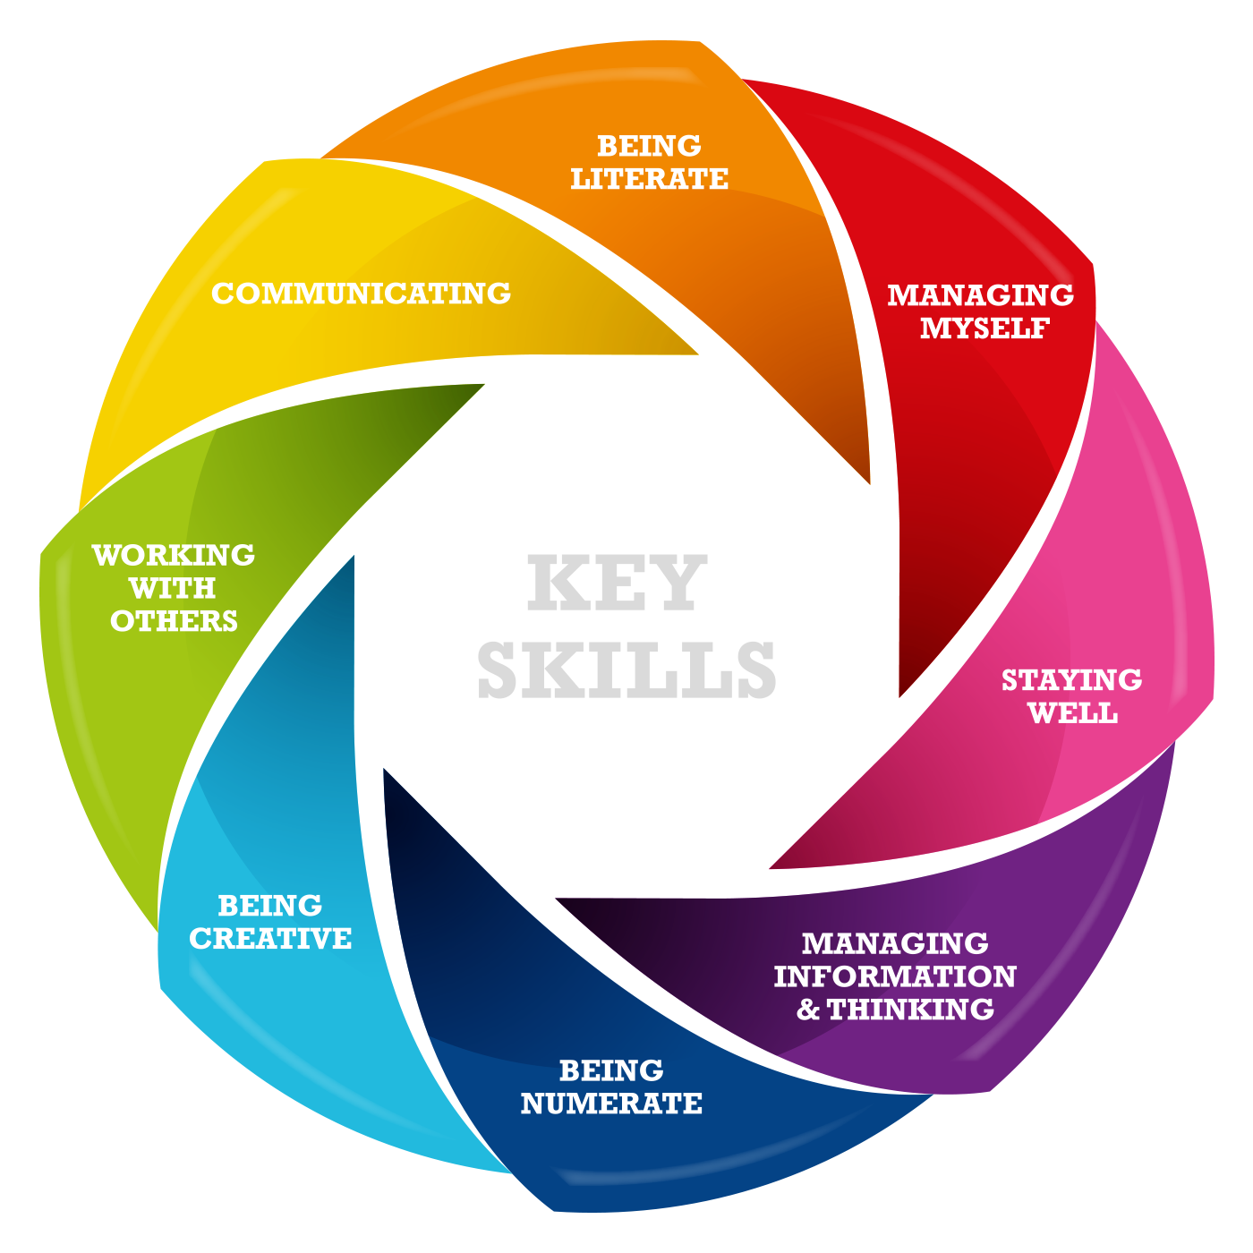
Notes:
Handout on the Key Skills
Show Poster

Slide 19
Structure of the Junior Cycle
Assessment and Reporting
Subjects
Short Courses
Wellbeing
Level 2 Learning Programmes
Other Learning Experiences
C
U
R
R
I
C
U
L
U
M
8 Key Skills
24 Statements of Learning
8 Principles
Notes:
Learning Intention: Overview of the Junior cycle framework.
Key Points:
Briefly remind participants that this is a recap on the framework for junior cycle.
Quickly state that it is based on the 8 Principles and the 24 statements of learning.
The key skills are embedded in the subject specifications and also experienced by the students through active methodologies in classes. The curriculum is delivered through the subjects, short courses, wellbeing, level2 learning programmes and other learning experiences.
Most students will study 8 subjects, with a maximum of 10 subjects to be studied by any student for certification. Students can substitute 2 short courses for one full subject
(maximum of 4 short courses for certification)
Classes must be 40 minutes minimum or we have the option of hour long classes.
40 mins planning.
English, Irish, Maths, Science
Short Course Example – programming and coding

Slide 20
Subjects
Art Craft Design
Short Courses
Civic, Social and Political Education
Digital Media Literacy
Social, Personal and Health Education
Physical Education
Chinese
Artistic Performance
Programming and Coding
Personal Project; Caring for Animals (Level 2)
...and school developed short courses.
Priority Learning Units
Level 2 Qualification
Such as...
Participating in Homework Club/After School Study
Junior/Senior Representative Council
Junk Kouture
Young Scientist
Badminton Club
Choir
Etc.
Communicating and Literacy
Numeracy
Looking after myself
Living in a community
Preparing for work
Business Studies
English
French
Geography
German
History
Home Economics
Irish
Italian
Jewish Studies
Materials Technology (Wood)
Mathematics
Metalwork
Music
Religious Education
Science
Spanish
Technical Graphics
Technology
Other learning experiences
Classics
Notes:
You’ll immediately recognise the subjects on this slide. They’re all fairly familiar. Subjects are usually 200 hours of student learning. Irish, English and Maths are 240 hours.
But there will also be short courses! Some of these have been developed by the NCCA and can be ‘taken off the shelf’ by schools choosing to include them in their junior cycle programme. These are listed here. But over time schools can also develop their own short courses locally to a template and guidelines set down by the NCCA. Short courses are usually 100 hours of class time.
Finally, schools can also time-table other shorter learning experiences as part of a new junior cycle such as those listed in the blue box.
We will talk about Level 2 in a later slide.

Slide 21
Subjects
8 – 10 subjects
English, Irish, Maths (minimum of 240 hours)
All other subjects (200 hours)
English, Irish, Maths (Higher and Ordinary Level)
All other subjects (Common Level)
Two hour state examination

Slide 22
Phased Introduction
Year | Subject/Course | JCPA
2014 | English | 2017
2016 | Science & Business Studies | 2019
2017 | Gaeilge, MFL, Art, Wellbeing | 2020
2018 | Maths, Home Ec, Music, History, Geography | 2021
2019 | Technology Subjects, RE, Classics, Jewish Studies | 2022
Notes:
Phased Replacement of the Junior Certificate
Junior Cycle Profile of Achievement
2017 – French, German, Spanish and Italian

Slide 23
Year | New Subjects your daughter will study as part of the New Junior Cycle
First Year Began in 2017 | English Science Business Studies Irish Art French German Wellbeing
Second Year Began in 2016 | English Science Business Studies
Third Year Began in 2015 | English

Slide 24
What is Wellbeing?
Student wellbeing is present when students realise their abilities, take care of their physical wellbeing, can copy with the normal stresses of life, and have a sense of purpose and belonging to a wider community.
Guidelines for Wellbeing in Junior Cycle, NCCA

Slide 25
Active
Wellbeing Indicators
Responsible
Connected
Resilient
Respected
Aware
Notes:
Learning intention: To outline the 6 wellbeing indicators.
Key Points:
As school plan their Wellbeing programme it is important that they have the flexibility to develop one that suits their students and their local context.
Six indicators, have been identified as central to wellbeing. Each indicator has a small number of descriptors. They can be used in a number of ways:
To review current provision for learning in well being
To plan teaching and learning within a schools Wellbeing programme.
To plan conversations.
To frame students self assessment about their learning in well being
To report on learning in well being.
Appendix 1 of the Wellbeing guidelines sets out how the learning outcomes in the NCCA developed short courses for CSPE, PE and SPHE can contribte to the well being

Slide 26
Wellbeing
PE
2 Classes
SPHE
1 Class
GUIDANCE
1 Class
CSPE
1 Class

Slide 27
Whole School Approach
All the day-to-day interactions that take place in a school, be they in our outside the classroom, can impact on a student’s wellbeing.
When students feel included, respected and listened to, they are more ready to learn and more successful in their learning and it can also influence young people’s outcomes as adults.
Notes:
We do a lot to cater for wellbeing in our school – Morning Prayer, Friendship Month, Sports Day.

Slide 28
Assessment
Students will present evidence of learning in a combination of subjects and short courses
Student will do school based work (CBA Classroom Based Assessment and AT Assessment Task) completed during 2nd and 3rd year and a final exam.
Students will be more responsible for creating, gathering and presenting evidence of their learning.
Notes:
Focus on school based assessment
Formative assessment
Focus on student feedback

Slide 29
School Based Assessment 2017/2018
Subject | 2nd Year | 3rd Year
English | March/April CBA (Teacher assessed) | Nov/Dec CBA (Teacher)+ AT (SEC)
Science | March/April CBA (Teacher assessed) | N/A
Business | March/April CBA (Teacher assessed) | N/A
Assessment Task + Final exam = grade on JCPA.
CBAs at Common Level.

Slide 30
Skills Emphasised in CBAs
Collaboration – working in teams
Investigation & Research
Communications
Use of ICT, managing information
Reporting – oral, written, graphical

Slide 31
Classroom Based Assessment In English
Classroom Based Assessment | Format | Student Preparation | Completion By
Oral Communication | Individual or group communication or presentation | During a period of three weeks, with support and guidance by teacher | End of Year Two
The Collection of the Student’s Texts | Two texts chosen by the student from his/her portfolio of texts | Texts produced over time with support and guidance by teacher | End of term 1, Year Three
Assessment Task | Format | Student Preparation | Completion By
 | Students complete a specified written task which is sent to the SEC for marking | The AT will be based on The Collection of the Student’s Texts | Following completion of the second Classroom Based Assessment

Slide 33
Achievement in CBA’s is reported using the following:
Descriptors
Exceptional
Above Expectations
In Line With Expectations
Yet to Meet Expectations

Slide 34
SLAR (Subject Learning and Assessment Review Meetings)
The SLAR meeting takes place after the CBA in each year.
SLAR meetings enable teachers to collaboratively reach consistency in their judgments of student work against common, externally set Features of Quality, not relative to other students.
Each meeting will:
be subject specific
be approximately two hours long
take place at a time as near as possible to the completion of the Classroom-Based Assessment
involve the review of student work related to a specific Classroom-Based Assessment.

Slide 36
New School Certificate and School Report
School Certificate (JCPA)
Also School Report – other achievements, attributes, certification and comments
Notes:
The school report will give more detailed information on your child’s learning in junior cycle
You will get a better idea on how well they are doing across a range of learning and achievements
Students could be asked to comment on their progress before the report is sent to you
A new report card template will be developed for each year of junior cycle. Examples of these report cards will be available soon.

Slide 37
How can I support my child’s learning?
Show interest, ask questions, listen and affirm
Read notes and progress reports that are sent home
Attend school meetings and events
Encourage your child to participate fully in learning opportunities both within and outside school

Slide 38
How can I support my child’s learning?
Encourage your child to develop skills and take on challenges in and out of school
Support them by creating structures and routines so that they can keep up with homework and project work
Promote good sleep, diet and exercise habits
If you need more information, please contact the school

Slide 39
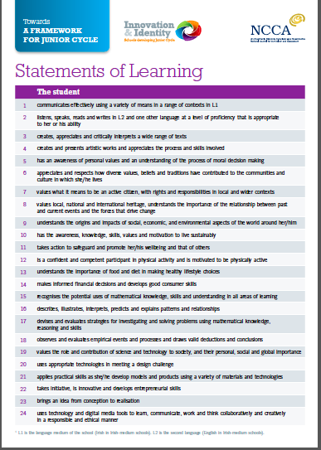
Useful Website
www.juniorcycle.ie

